Slide 1

US Disease Analysis
Data Visualization
Email:
raphael.griffo-duarte@stud.th-deg.de
mahmoud.hamed@stud.th-deg.de
Raphael Griffo Duarte 22111783
Mahmoud Ahmed Saad Hamed 12204926

Slide 2
Table of Content
Introduction
Problem definition
Objectives
Methods
5.1 Analysis Protocol
5.2 Historical analysis
5.3 Historical and Geographical Analysis
5.4 Lethality analysis
5.5 Lethality Maps
6. Results
Conclusions
Literature

Slide 3
Introduction
The Tycho dataset offers crucial disease information for the United States at state and city levels from 1887 to 2014. It provides insights into disease patterns and trends across the country.
The COVID-19 pandemic emphasizes the need for better preparedness and response to large-scale outbreaks. The dataset helps identify high-risk areas and populations, enabling targeted interventions to prevent disease spread. Analysing this data aids in preparing for future pandemics and improving response effectiveness.
This study aims to explore the relationship between geography and disease spread and lethality, using Tycho's state-level statistics on cases and deaths. It can guide resource allocation and potentially save lives through disease prevention.

Slide 4
Problem definition
Addressing resource allocation and pandemic preparedness requires a comprehensive approach. Detecting and responding to pandemics effectively demands a tailored healthcare system based on regional needs. Variations in climate, distance, and population density in the United States pose challenges to adequate preparation.
Different regions may require specific resources depending on their unique characteristics. A targeted approach, considering individual region's requirements, ensures appropriate resource allocation and improves pandemic response capabilities.

Slide 5
Objectives
This research aims to examine the correlation between geography and disease prevalence. Identifying prevalent diseases in each region allows for better resource allocation, focusing on prevention and treatment where needed most. This approach saves resources, enables tailored strategies, and addresses region-specific challenges. Additionally, investigating environmental factors contributing to disease spread enhances understanding of how geography interacts with other variables, impacting health outcomes.
The objective is to gain insights into the complex relationship between geography and disease, developing effective approaches to mitigate their impact on vulnerable populations.

Slide 6
Methods
The method consists in analysing and comparing the disease data on state level, to understand if and how diseases affect different states. We assume that there should be a difference, due to climate, so we investigate if states with similar climates will show similar trends in disease.
Methods from descriptive statistics: Descriptive Statistics
Statistics for scientific work: Literate Statistical Analysis
Advanced-Data visualization techniques: ggplot2

Slide 7
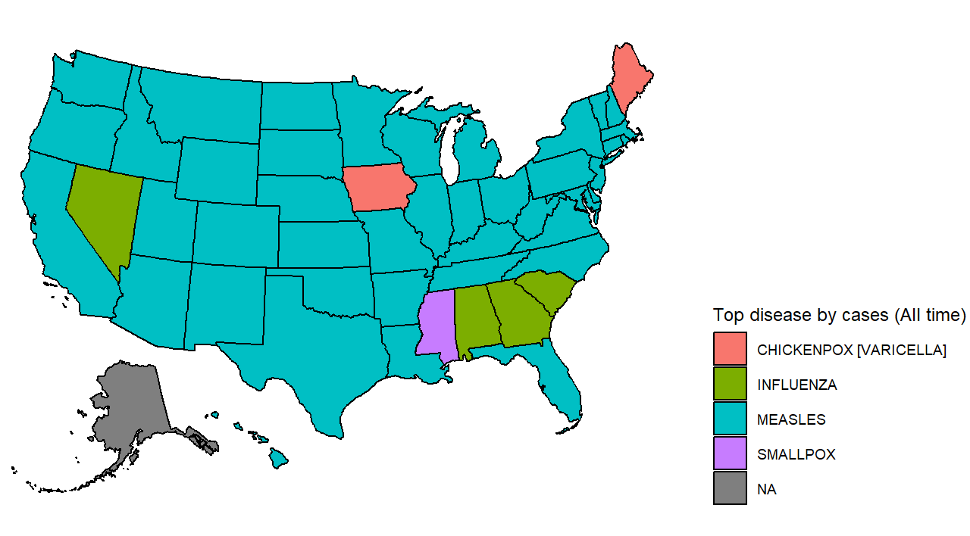
Analysis Protocol
Overall disease view
Since we start from the assumption that geography affects diseases, the first step is to look at the data, seeing what is the disease with most cases for each state. For that visualization we will use all rows of cases and on city level.
From the graph it is possible to state that the main diseases in number of cases throughout history are: - Chickenpox
Influenza
Measles
Smallpox

Slide 8
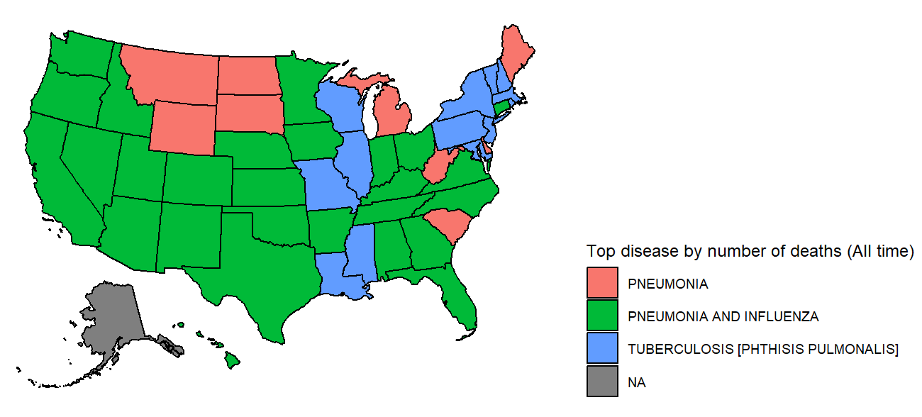
Analysis Protocol (Cont..)
Only looking at the cases is not enough though. The dataset also contains death information for the diseases, so the same process is applied to find what are the most deadly diseases throughout history by state.
The disease with most cases is not the most deadly. From the dataset, the death data for measles, for example, is missing. The solution for that, is to not use measles data when comparing the information from deaths.
disease | event | total
MEASLES | CASES | 25416988

Slide 9
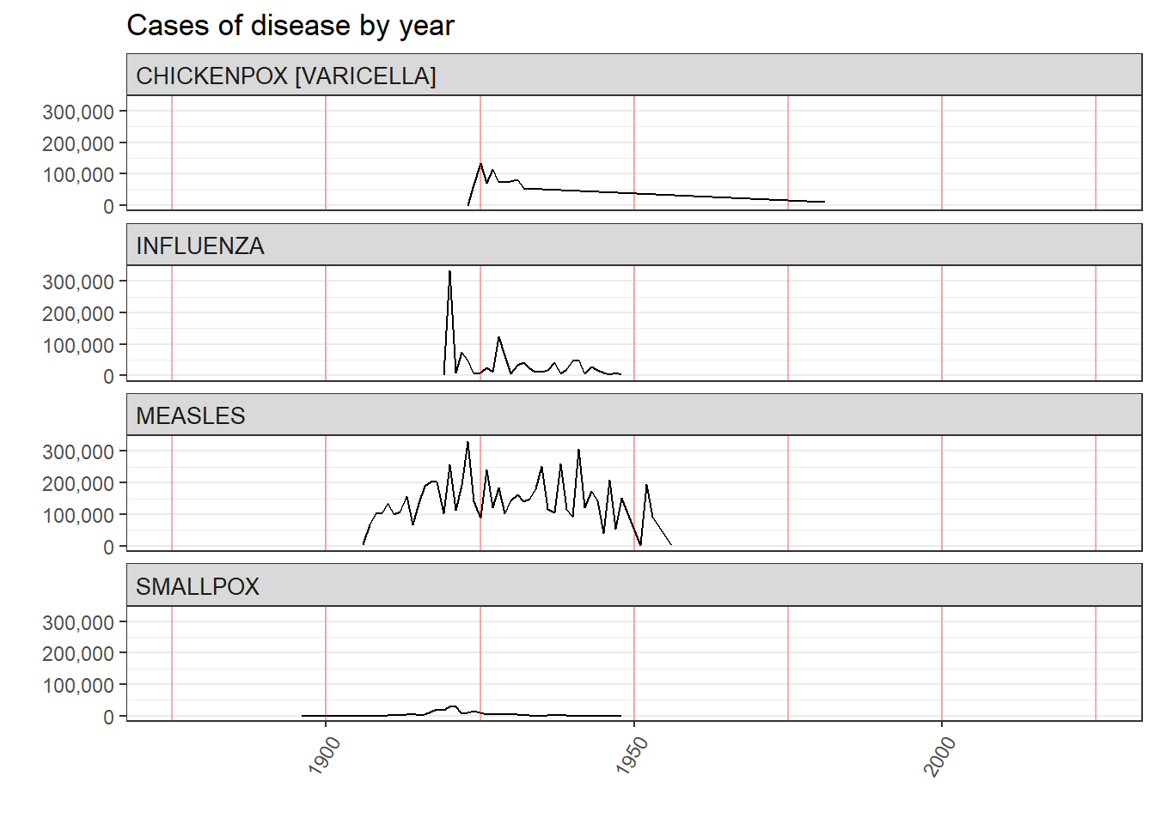
Historical analysis
Historical data shows ongoing prevalence of eradicated diseases like Measles and Smallpox in many states.
Examining the yearly number of cases nationwide helps understand their historical behavior.

Slide 10
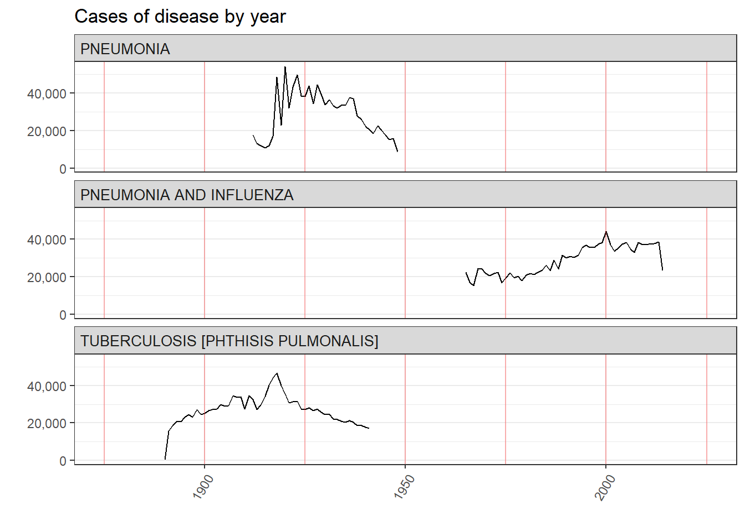
Historical analysis (cont..)
Similarly, looking at how deaths caused by diseases behaved in time:

Slide 11
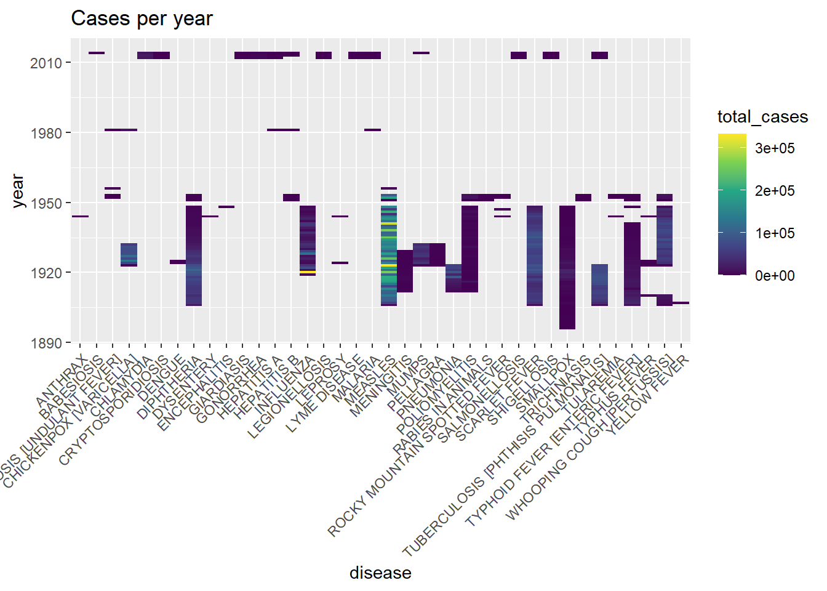
Historical analysis (cont..)
Since this type of visualization is limited in the number of diseases we can see at the same time, one alternative is viewing through a heat map.

Slide 12
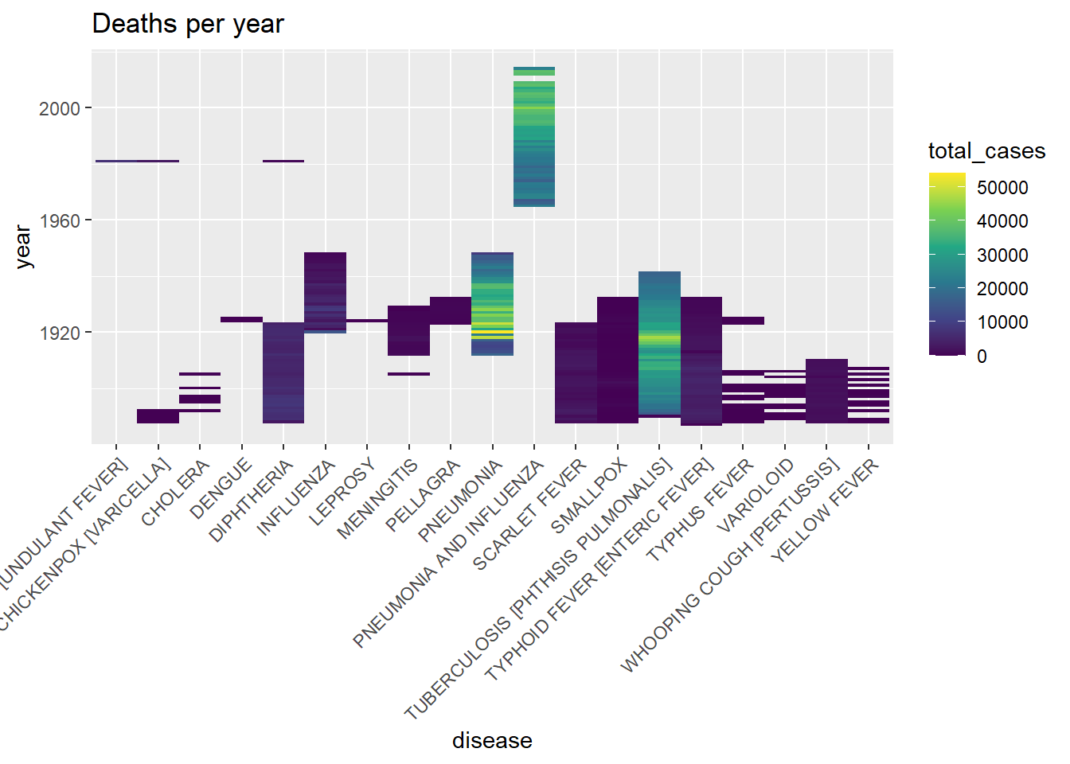
Historical analysis (cont..)
Similarly, looking at how deaths caused by diseases behaved in time:

Slide 13
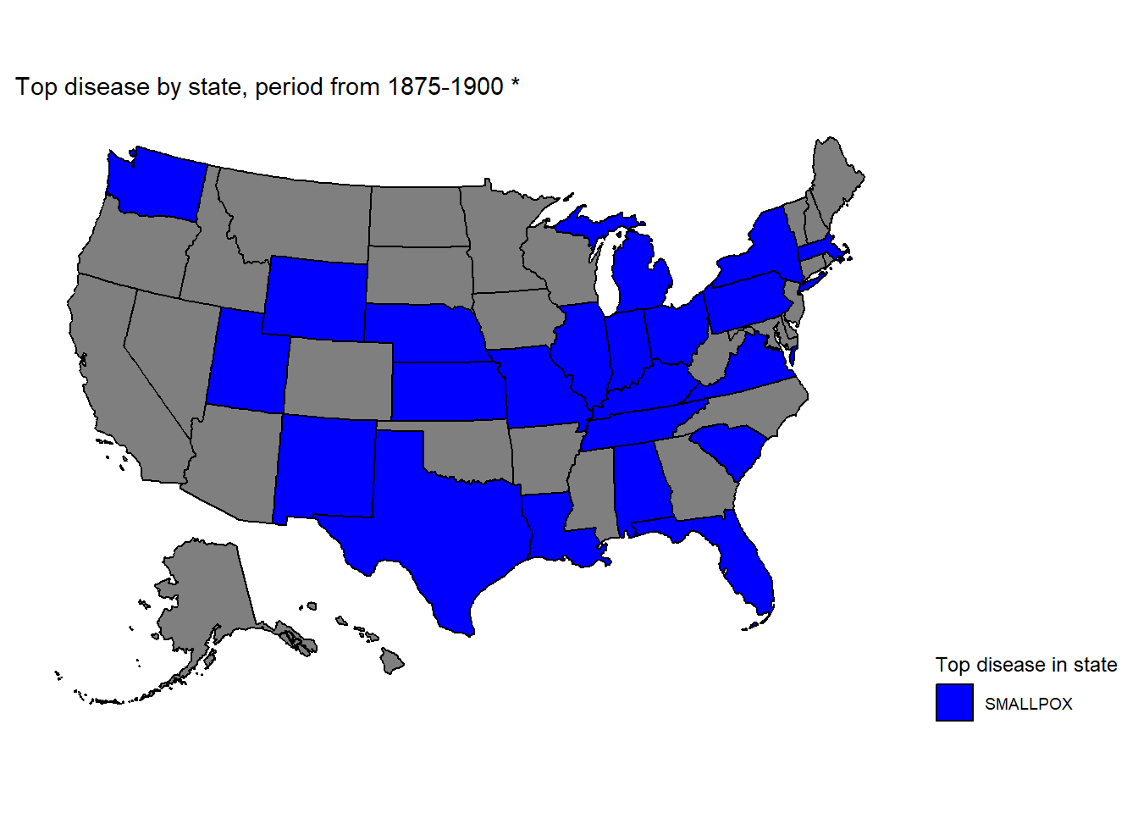
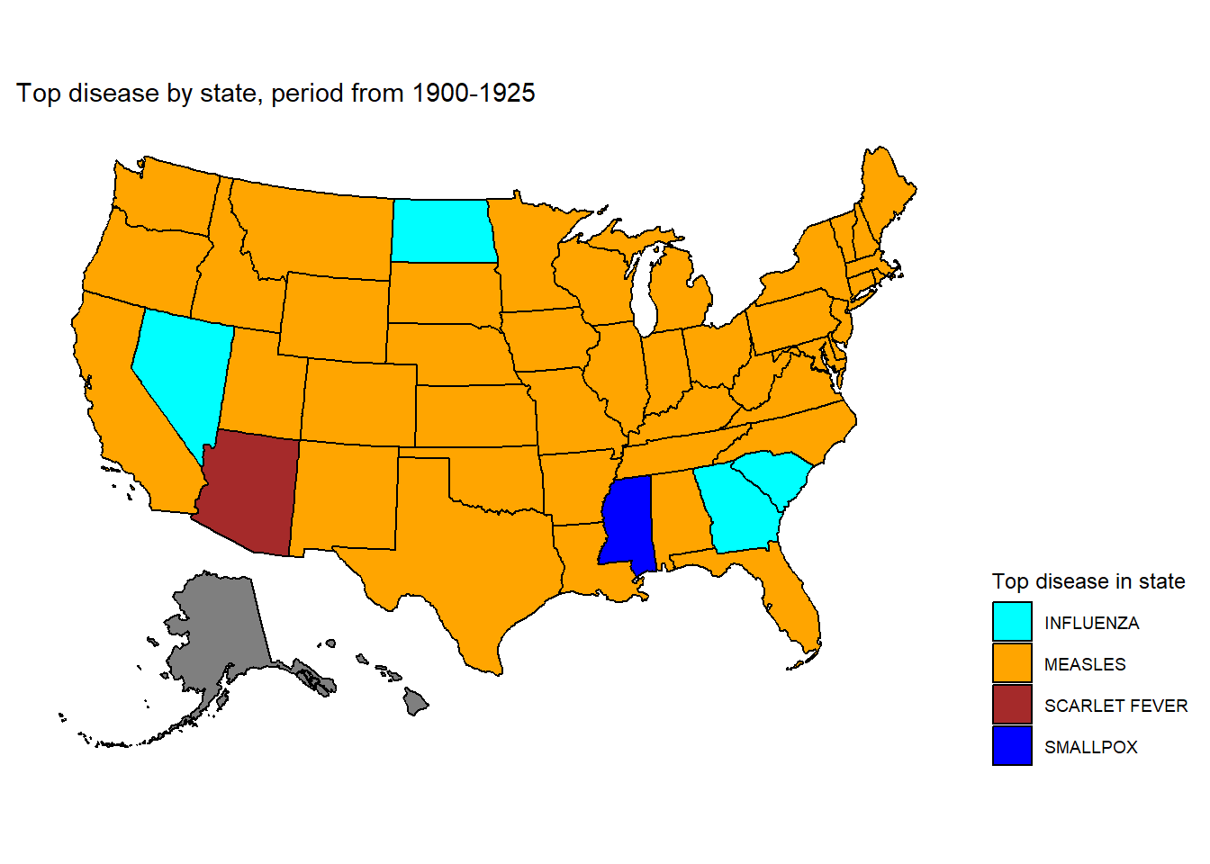
Historical and Geographical Analysis
The diseases only happened in a few moments through history and either were not counted anymore or were eradicated. (de Quadros, et. al.). The next step is to generate aa different map for those periods, to see how different diseases affected each state at each point in time;

Slide 14
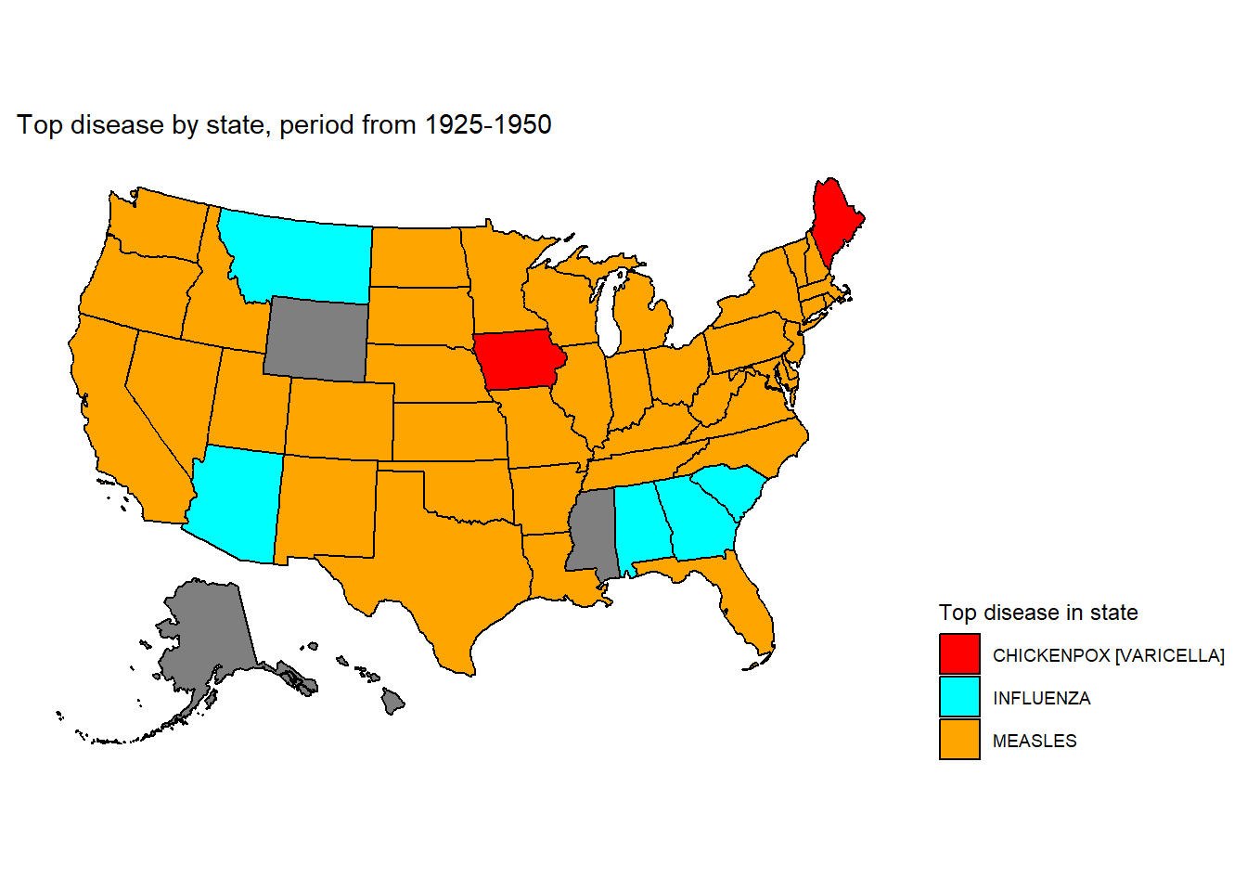
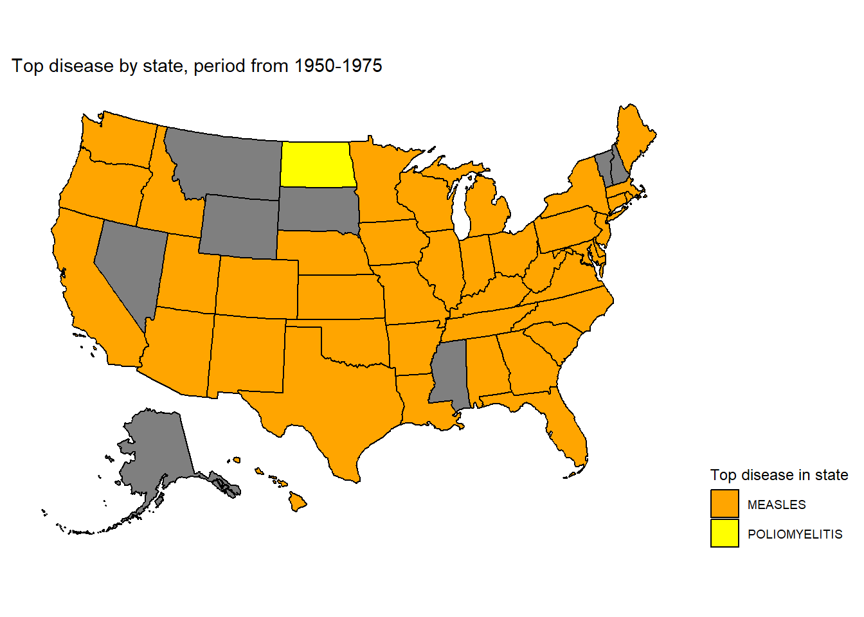
Historical and Geographical Analysis (cont..)

Slide 15
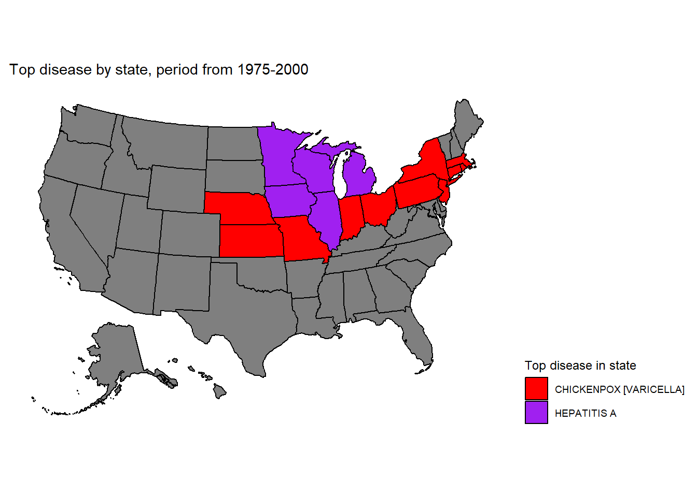
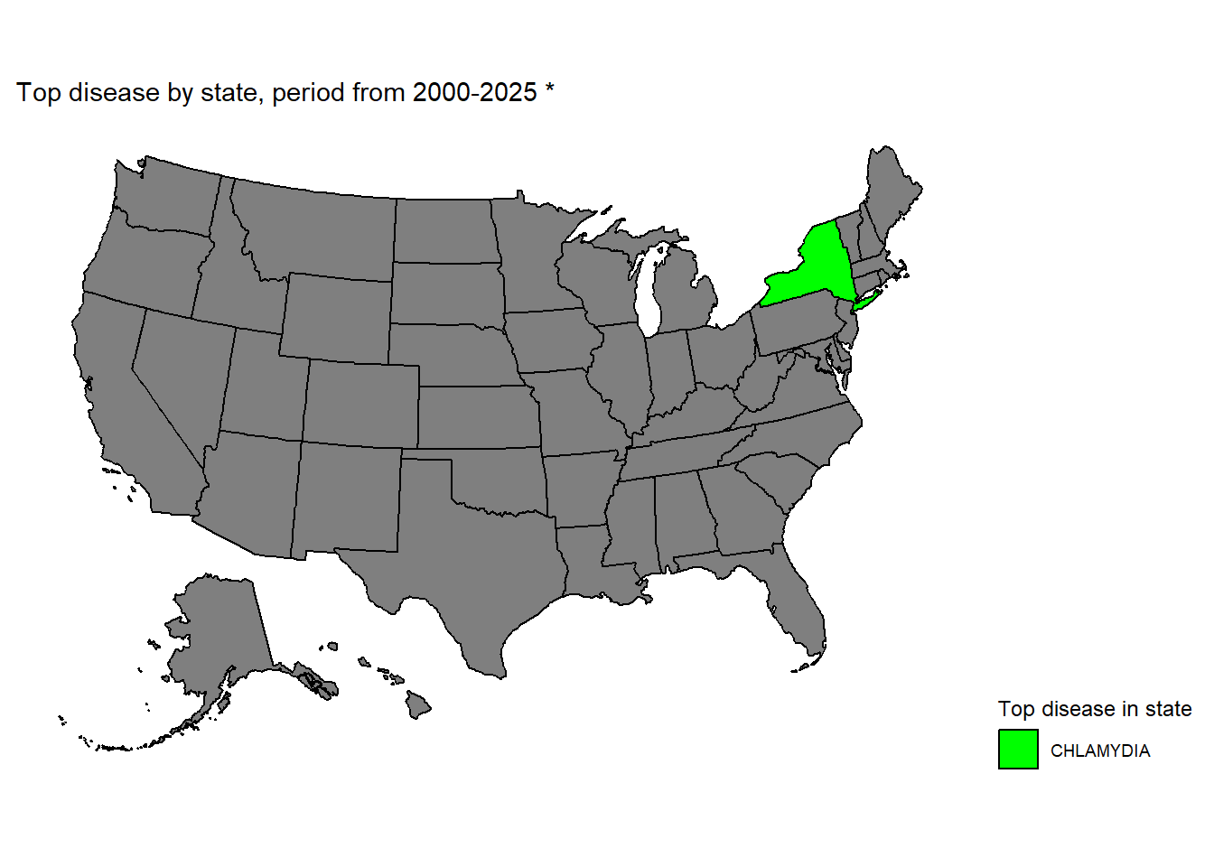
Historical and Geographical Analysis (cont..)

Slide 16
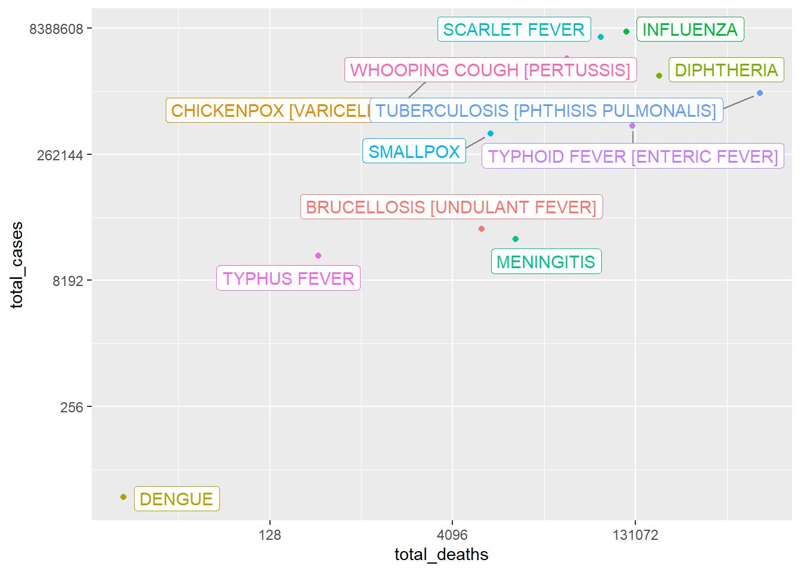
Lethality analysis
Lethality analysis is important due to population variations. Instead of using population data, we can calculate lethality by dividing deaths by cases.
The chart shows a correlation between cases and deaths, as expected. The number of deaths should never be higher than the number of cases, as it would make little sense. Both axis show absolute values, so it is a good comparison about the scale of each disease, but not clear enough to know how they compare in terms of lethality.

Slide 17
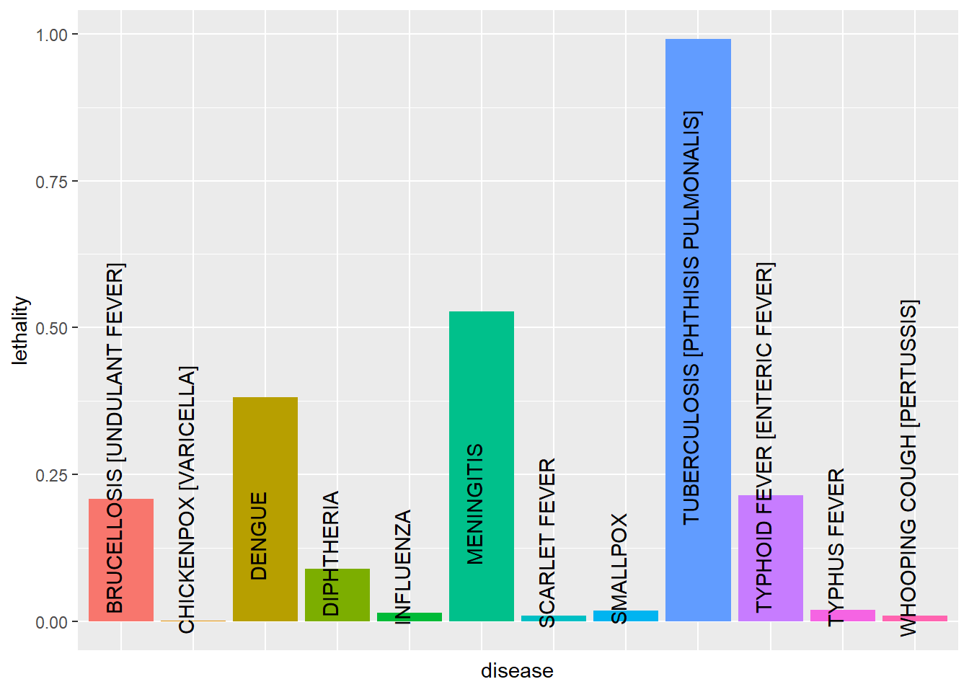
Lethality analysis (cont..)
Knowing the most lethal diseases can help find a direction on what treatments should be prioritized and what diseases should be prevented from spreading at all cost. But going back to the main subject of the geographical effects on disease lethality, the next graph will illustrate how the letality varies in each disease for each state:

Slide 18
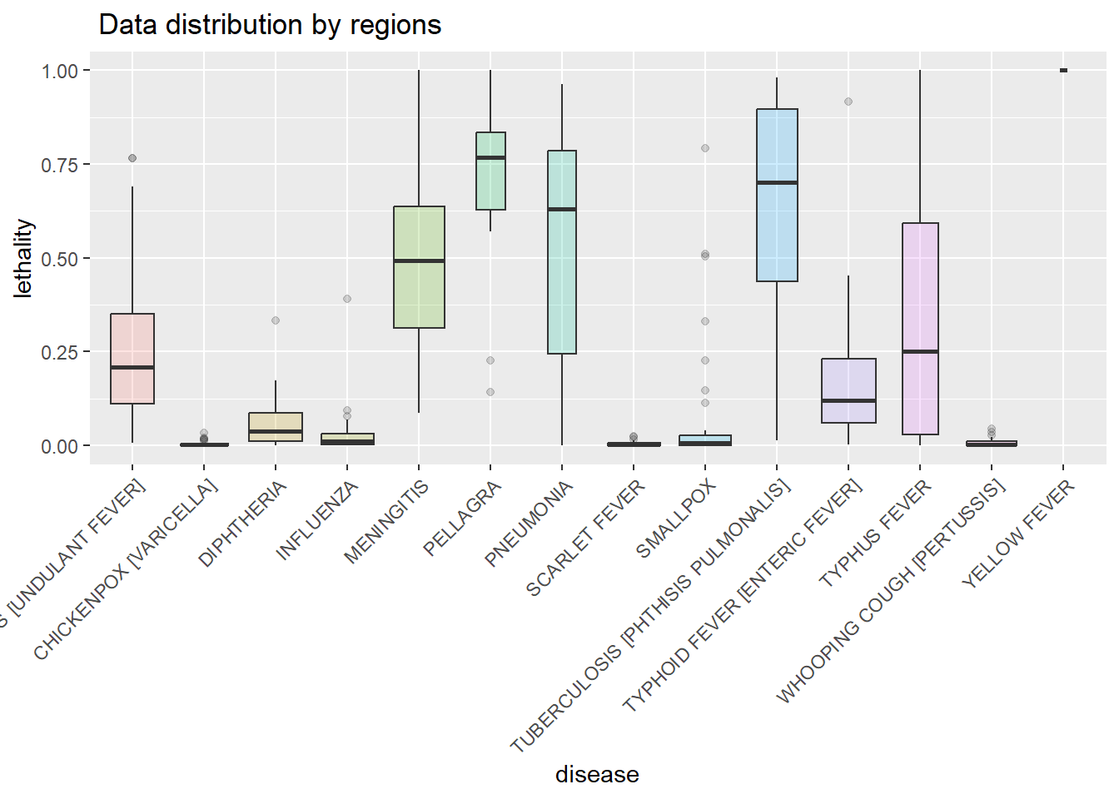
Lethality analysis (cont..)
The graph shows that there are outliers in lethality, but low and high, for certain diseases: Diphtheria, Influenza, Pellagra, Smallpox and Typhoid Fever. For reference, Tuberculosis will also be included, as it is highly lethal but more evenly distributed

Slide 19
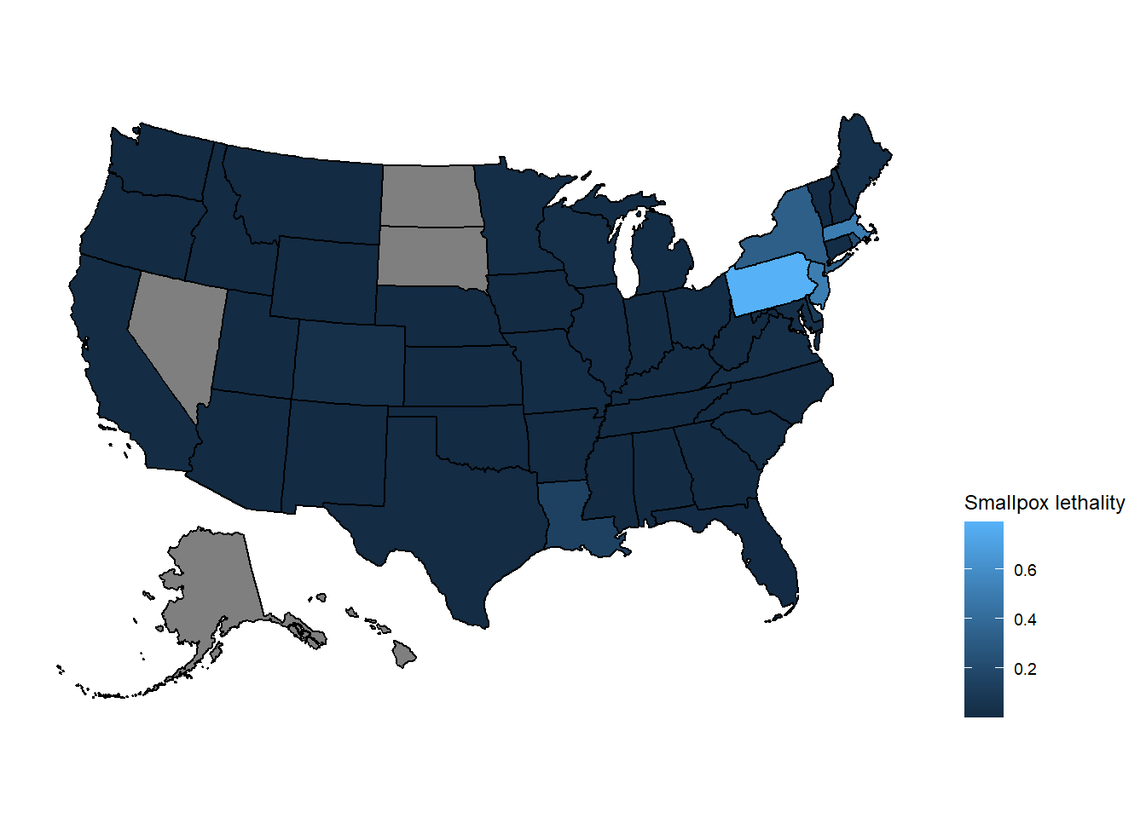
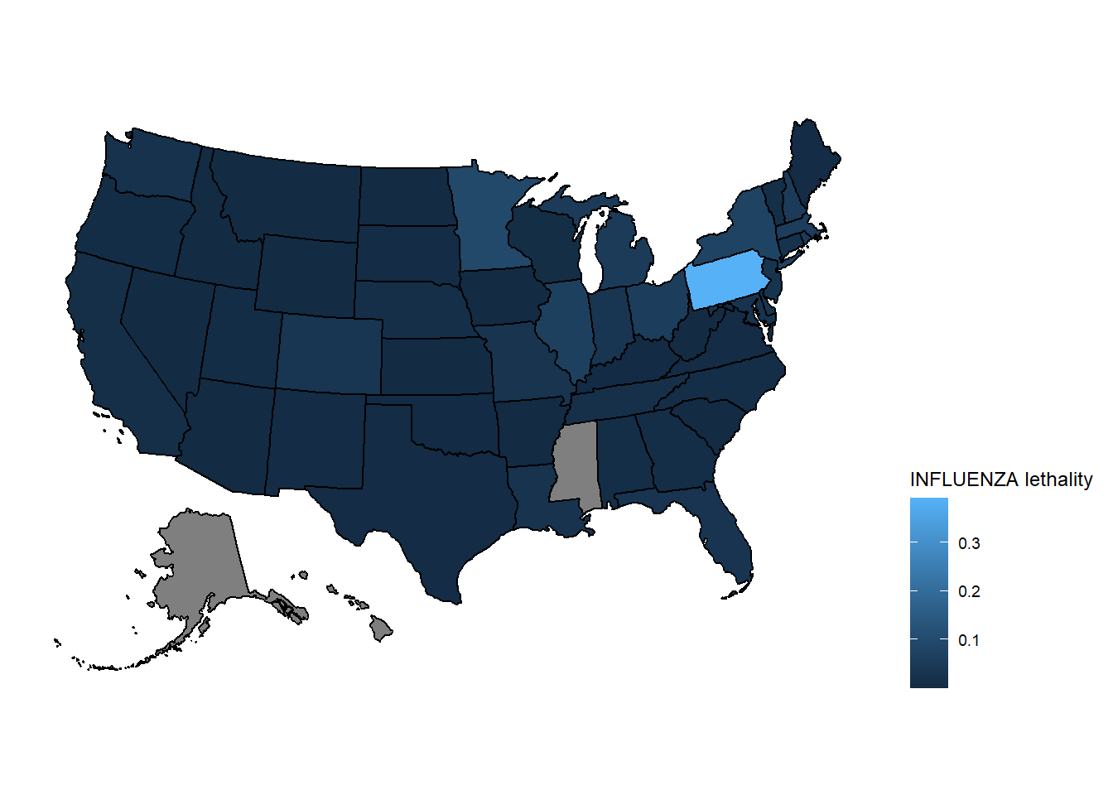
Lethality Maps

Slide 20
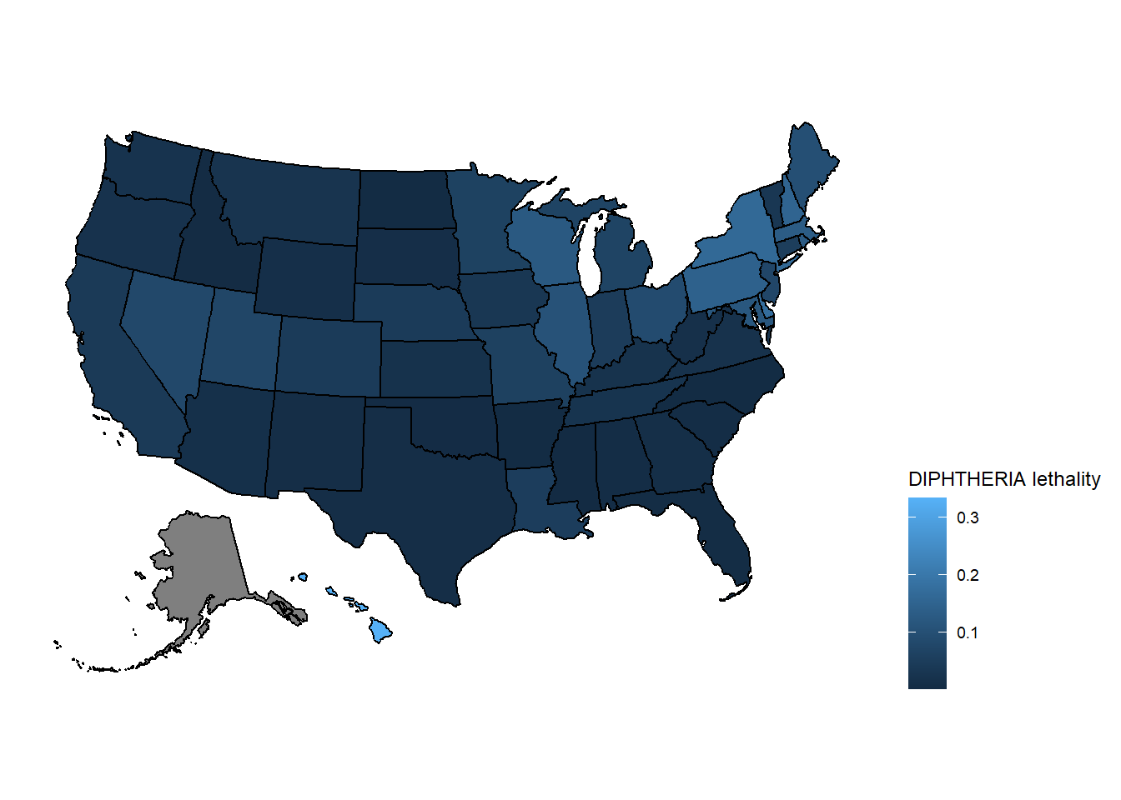
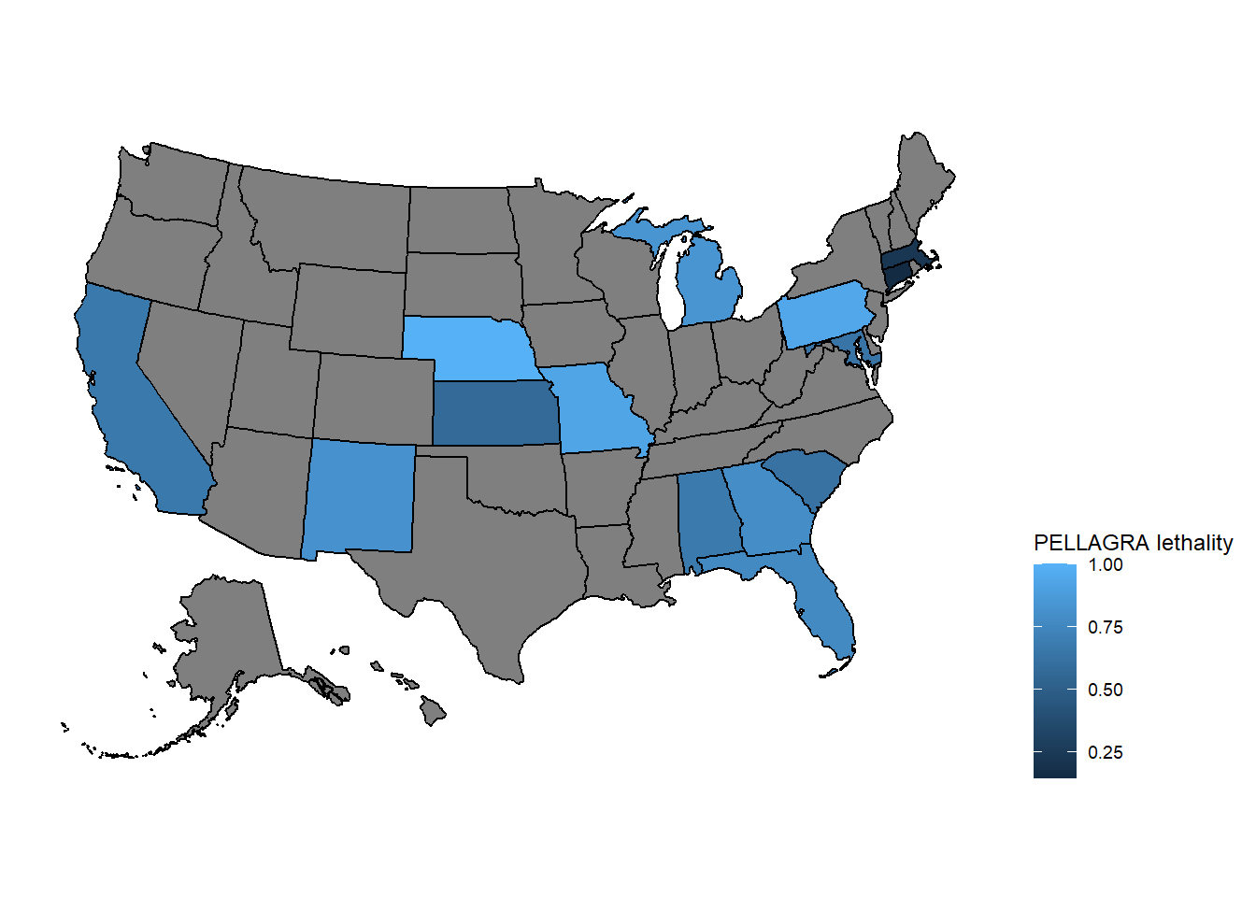
Lethality Maps (cont..)

Slide 21
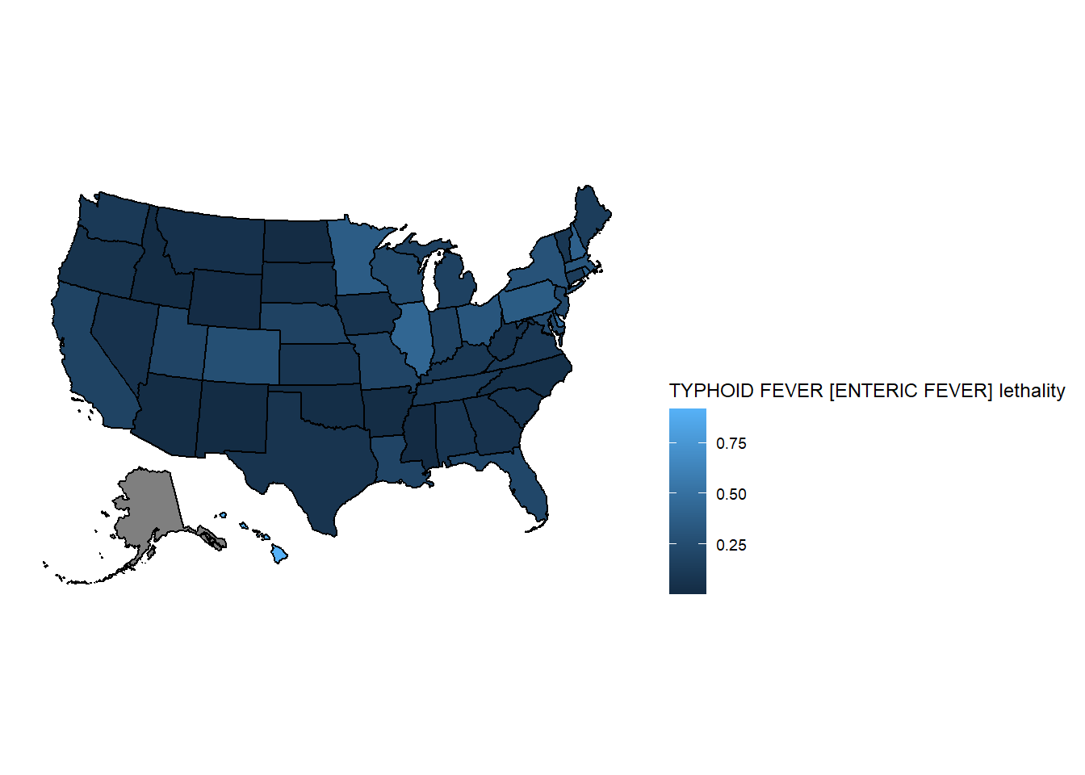
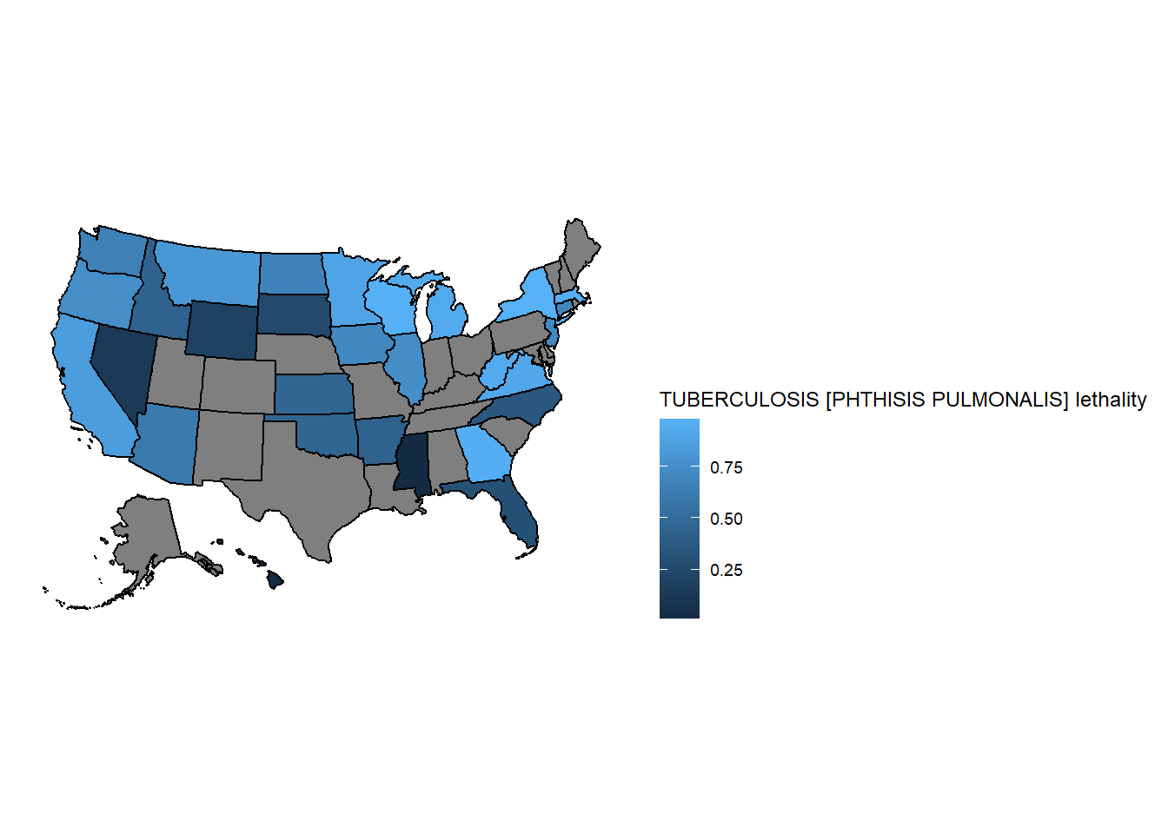
Lethality Maps (cont..)
The maps show that certain states, mainly in the northeast, are more dangerous for those diseases, all of them being respiratory diseases. A takeaway from that data is that perhaps the air pollution in those heavily industrialized areas can generate higher risk of illness and higher chance of death. So resources for respiratory diseases should be prioritized in the states of that region.

Slide 22
Result
The results analysed in this work:
Disease trends over time
Disease case map
Disease death map
Disease lethality
Lethality map

Slide 23
Discussion
Pros:
- The dataset contain multiple diseases and states, making it possible to find useful patterns
Cons:
The data is not constant, some diseases have cases in certain periods but no data afterwards. That is reasonable for eradicated diseases, but even diseases like Influenza are missing.
The data is not present for all states and diseases

Slide 24
Conclusion
Our data visualization project reveals that disease lethality is influenced by the state or region. This underscores the need for targeted planning and resource allocation in heavily impacted areas, potentially saving lives.
Understanding the root causes of higher lethality in specific regions informs effective interventions and preventive measures. Addressing socio-economic conditions, healthcare accessibility, environmental factors, and population characteristics can tackle underlying determinants of disease severity.
Collaboration between researchers, public health institutions, and community stakeholders enables evidence-based strategies. Tailored interventions for different regions improve overall health outcomes.

